Slide 1
Chapter 7 Supplement
(More on Manipulating Bits)

Slide 2
Using ASR to produce 0 or +/- 1
ASR R0,R1,31 // R0 = -1 if R1 < 0, else 0
NEG R0,R0 // R0 = +1 if R1 < 0, else 0

Slide 3
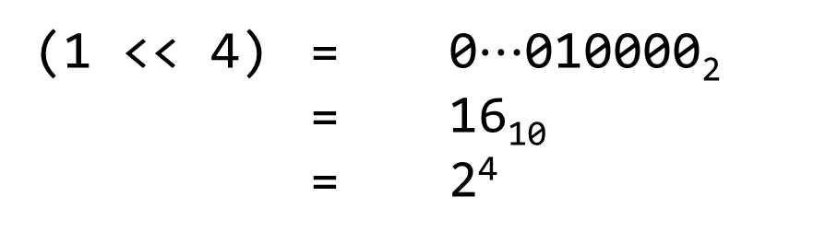
(1 << k) = 2^{k} (A single 1 shifted left k bits)
(1 << 4) = 0$⋯$010000₂
= 16₁₀
= 2⁴
// If k is a constant
LDR R0,1<<4
// If k is a variable
LDR R0,=1 LDR R1,k LSL R0,R0,R1

Slide 4
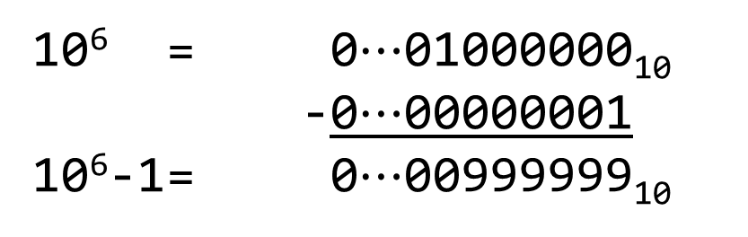
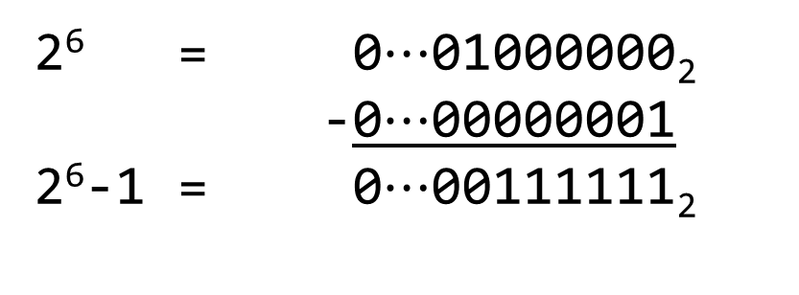
2^{k}-1 (A string of k 1’s)
10⁶ = 0$⋯$01000000₁₀
-0$⋯$00000001
10⁶-1 = 0$⋯$00999999₁₀
// If k is a constant
LDR R0,(1<<6)-1
Six 9’s
// If k is a variable
LDR R0,=1 LDR R1,k LSL R0,R0,R1
SUB R0,R0,1
2⁶ = 0$⋯$01000000₂
-0$⋯$00000001
2⁶-1 = 0$⋯$00111111₂
Six 1’s

Slide 5

Is $x$ a Power of 2?
Any 1’s here will cause 1’s to appear in R1 after the SUB
Any power of 2 will be all 0’s except for a single 1
LDR R0,x
SUB R1,R0,1
TST R0,R1
BEQ IsPowerOf2
0 | 0 | 0 | 1 | 0 | 0 | 0 | 0
0 | 0 | 0 | 0 | 1 | 1 | 1 | 1
0 | 0 | 0 | 0 | 0 | 0 | 0 | 0
These bits of the result will be zero if x is a power of 2
TST is a Bitwise-AND that discards the result, but sets the flags
DIsclaimer: This code detects x=0 as a power of 2.

Slide 6
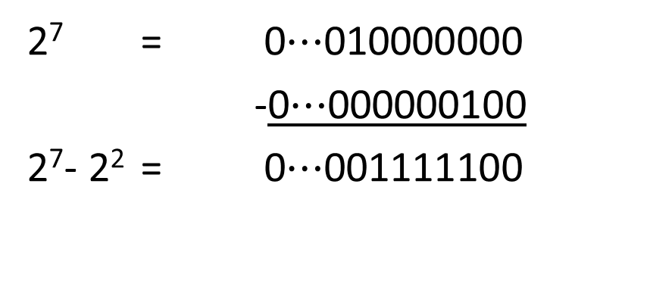
2^{k}-2^{n} = 2^{n}(2^{k-n}-1) (A string of k 1’s shifted left n bits)
2⁷ = 0$⋯$010000000
-0$⋯$000000100
2⁷- 2² = 0$⋯$001111100
// If k and n are constants
LDR R0,(1<<7)-(1<<2)
// If k and n are variables
LDR R0,=1 LDR R1,k
LDR R2,n
LSL R1,R0,R1 // 1 << k
LSL R2,R0,R2 // 1 << n
SUB R0,R1,R2
Five 1’s, shifted left by 2 bits

Slide 7
Bitwise-AND
a | b | a & b
0 | 0 | 0
0 | 1 | 0
1 | 0 | 0
1 | 1 | 1
0 & b = 0
1 & b = b
R0
b31 | $$⋯$$ | b5 | b4 | b3 | b2 | b1 | b0
0 | $$⋯$$ | 0 | 1 | 1 | 1 | 0 | 0
AND R1,R0,0b11100
R1
0 | $$⋯$$ | 0 | b4 | b3 | b2 | 0 | 0

Slide 8
Extracting Right-Aligned Unsigned Bitfield (Using Bitwise-AND to Insert 0’s)
31 |  |  |  |  |  |  |  |  |  |  |  |  |  |  |  |  |  |  |  | 11 | 10 |  |  |  |  |  |  |  |  |  | 0
? | ? | ? | ? | ? | ? | ? | ? | ? | ? | ? | ? | ? | ? | ? | ? | ? | ? | ? | ? | ?
width = 11
AND R0,R0,(1 << 11) -1
31 |  |  |  |  |  |  |  |  |  |  |  |  |  |  |  |  |  |  |  | 11 | 10 |  |  |  |  |  |  |  |  |  | 0
0 | 0 | 0 | 0 | 0 | 0 | 0 | 0 | 0 | 0 | 0 | 0 | 0 | 0 | 0 | 0 | 0 | 0 | 0 | 0 | 0

Slide 9
Using ASR to produce a bitmask
// Selection: if (R0 < 0) R5 = R2 ; else R5 = R4
AND R2,R1,R0,ASR 31 // R2 = R1 if R0 < 0, else 0
NEG R0,R0 // R0 = -R0
AND R4,R3,R0,ASR 31 // R4 = R3 if R0 < 0, else 0
ORR R5,R3,R4 // Either R3 or R4 will be 0

Slide 10
Extracting Unsigned Bitfields (Without UBFX)
width = 9
31 |  |  |  |  |  |  | 24 | 23 |  |  |  |  |  |  |  | 15 | 14 |  |  |  |  |  |  |  |  |  |  |  |  |  | 0
lsb = 15
LSL R0,R0,8
32 – (lsb + width) = 8
31 |  |  |  |  |  |  |  | 23 | 22 |  |  |  |  |  |  |  |  |  |  |  |  |  | 8 | 7 |  |  |  |  |  |  | 0
 |  |  |  |  |  |  |  |  |  |  |  |  |  |  |  |  |  |  |  |  |  |  |  | 0 | 0 | 0 | 0 | 0 | 0 | 0 | 0
32 – len = 23
LSR R0,R0,23
31 |  |  |  |  |  |  |  |  |  |  |  |  |  |  |  |  |  |  |  |  |  | 9 | 8 |  |  |  |  |  |  |  | 0
0 | 0 | 0 | 0 | 0 | 0 | 0 | 0 | 0 | 0 | 0 | 0 | 0 | 0 | 0 | 0 | 0 | 0 | 0 | 0 | 0 | 0 | 0

Slide 11
Extracting Signed Bitfields (Without SBFX)
width = 9
31 |  |  |  |  |  |  | 24 | 23 |  |  |  |  |  |  |  | 15 | 14 |  |  |  |  |  |  |  |  |  |  |  |  |  | 0
 |  |  |  |  |  |  |  | s
lsb = 15
LSL R0,R0,8
32 – (lsb + width) = 8
sign bit
31 |  |  |  |  |  |  |  | 23 | 22 |  |  |  |  |  |  |  |  |  |  |  |  |  | 8 | 7 |  |  |  |  |  |  | 0
s |  |  |  |  |  |  |  |  |  |  |  |  |  |  |  |  |  |  |  |  |  |  |  | 0 | 0 | 0 | 0 | 0 | 0 | 0 | 0
32 – len = 23
ASR R0,R0,23
31 |  |  |  |  |  |  |  |  |  |  |  |  |  |  |  |  |  |  |  |  |  | 9 | 8 |  |  |  |  |  |  |  | 0
s | s | s | s | s | s | s | s | s | s | s | s | s | s | s | s | s | s | s | s | s | s | s | s

Slide 12
Bitwise-OR
a | b | a | b
0 | 0 | 0
0 | 1 | 1
1 | 0 | 0
1 | 1 | 1
0 | b = b
1 | b = 1
R0
b31 | $$⋯$$ | b5 | b4 | b3 | b2 | b1 | b0
0 | $$⋯$$ | 0 | 1 | 1 | 1 | 0 | 0
ORR R1,R0,0b11100
R1
b31 | $$⋯$$ | b5 | 1 | 1 | 1 | b1 | b0

Slide 13
Using Bitwise-OR to Combine Bitfields
a | b | a | b
0 | 0 | 0
0 | 1 | 1
1 | 0 | 0
1 | 1 | 1
0 | b = b
1 | b = 1
Must be 0’s
R0
a31 | $$⋯$$ | a5 | a4 | 0 | 0 | 0 | 0
R1
0 | $$⋯$$ | 0 | 0 | b3 | b2 | b1 | b0
Must be 0’s
ORR R2,R1,R0
R2
a31 | $$⋯$$ | a5 | a4 | b3 | b2 | b1 | b0

Slide 14
Inserting Bitfields (Without BFI)
R1
? | $$⋯$$ | ? | ? | ? | b2 | b1 | b0
R0
a31 | $$⋯$$ | a5 | ? | ? | ? | a1 | a0
BIC R0,R0,0b11100
R0
a31 | $$⋯$$ | a5 | 0 | 0 | 0 | a1 | a0
R1
? | $$⋯$$ | ? | b2 | b1 | b0 | 0 | 0
LSL R1,R1,2
AND R1,R1,0b11111
0 | $$⋯$$ | 0 | b2 | b1 | b0 | 0 | 0
ORR R0,R0,R1
a31 | $$⋯$$ | a5 | b2 | b1 | b0 | a1 | a0

Slide 15

Exclusive-OR Absolute Value
All 1’s if s32 < 0
All 0’s if s32 ≥ 0
// uint32_t AbsValue(int32_t s32) AbsValue: // s32 < 0: else: EOR R1,R0,R0,ASR 31 // R1 = ~s32 R1 = s32 SUB R0,R1,R0,ASR 31 // R0 = ~s32 + 1 R0 = s32 BX LR // Return
-1 if s32 < 0
0 if s32 ≥ 0
Fast! Avoids using making a compare and branch so that the instruction pipeline never stalls.

Slide 16
Exclusive-OR Swap of R0 and R1
Exclusive-OR is 1 wherever the bits are different
// Standard method
// (requires 3rd register)
MOV R2,R0
MOV R0,R1
MOV R1,R2
// Exclusive-OR method
// No extra registers needed
EOR R0,R0,R1
EOR R1,R0,R1
EOR R0,R0,R1
R0
R1
1011
0011
1000
1011
0011

Slide 17
More Bit-Manipulation Tricks: http://graphics.stanford.edu/~seander/bithacks.html

